Slide 1
HYPERNOVA
Selected Work
A few of the sites and platforms we've designed and built
hyper-nova.co.uk

Slide 2
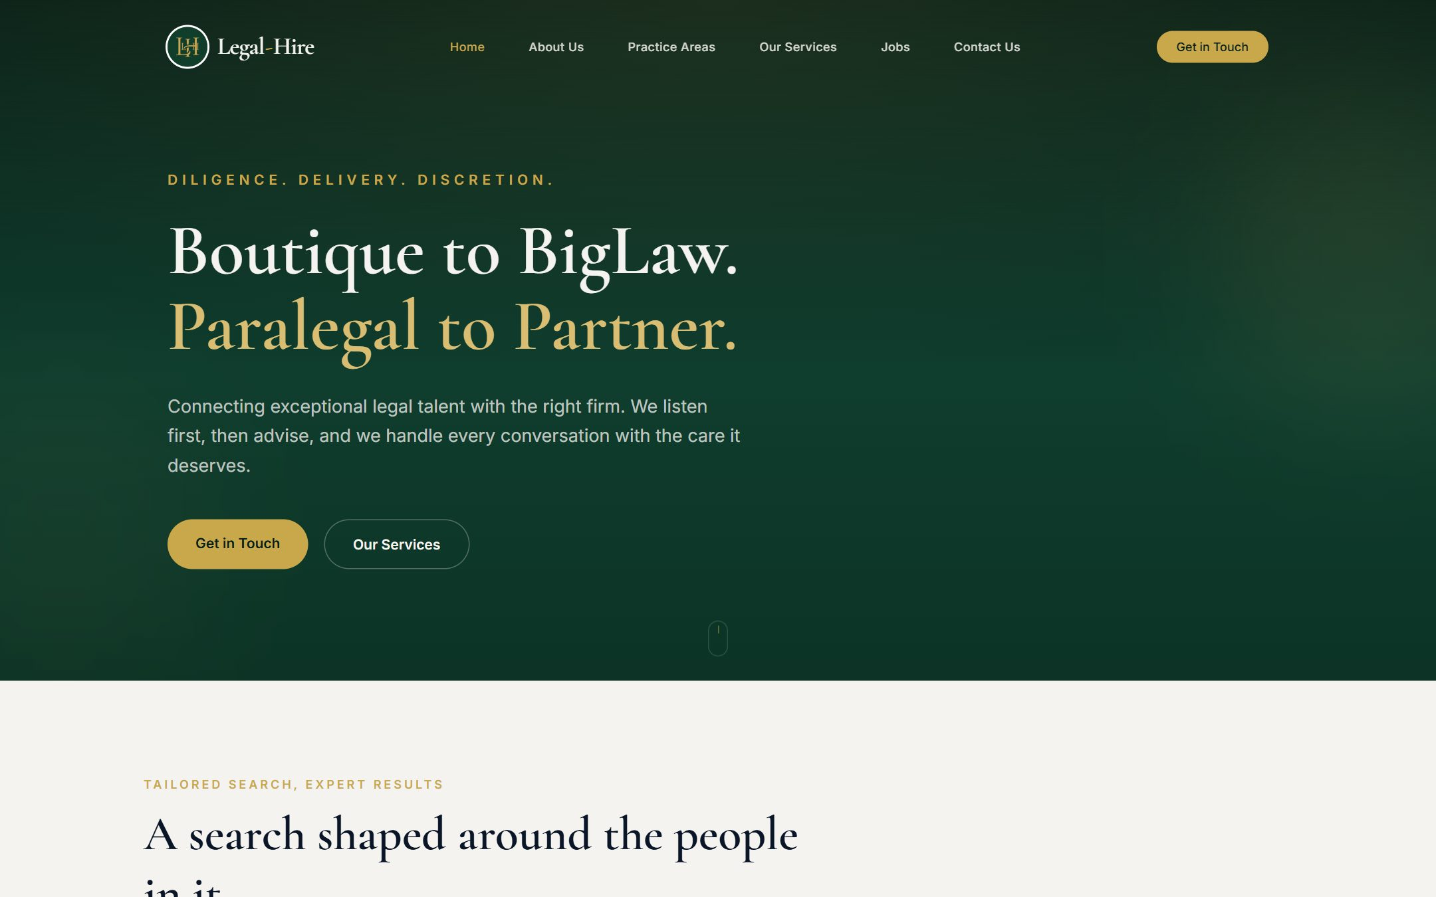
01
Legal-Hire
Boutique legal recruitment · Website & brand
An elegant, editorial site for a boutique legal recruiter. Confident typography and copy that sells discretion from paralegal to partner.
WEB DESIGN · BRANDING · RECRUITMENT
▸ legal-hire.co

Slide 3
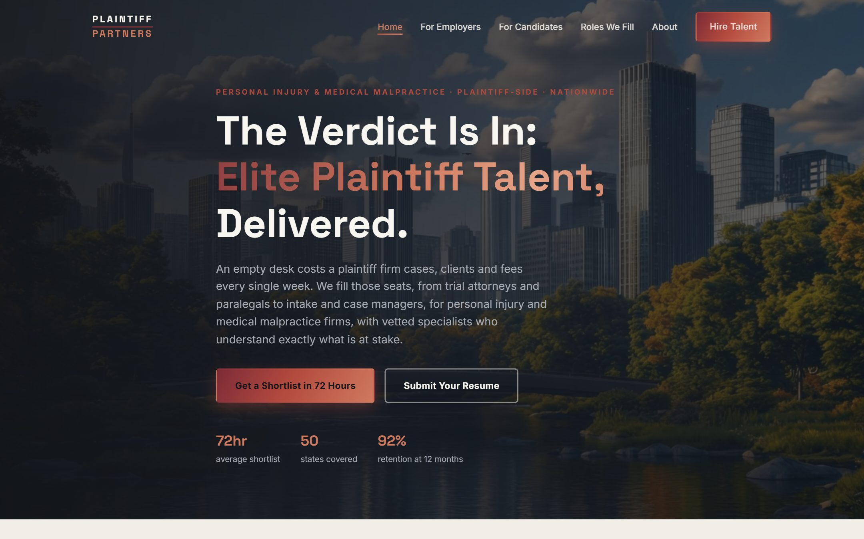
02
Plaintiff Partners
Personal injury legal recruitment · Website & brand
A high-trust site for a personal injury and medical malpractice legal recruiter. Separate paths for firms and candidates, built to win instructions fast.
WEB DESIGN · BRANDING · LEGAL RECRUITMENT
▸ Private build

Slide 4
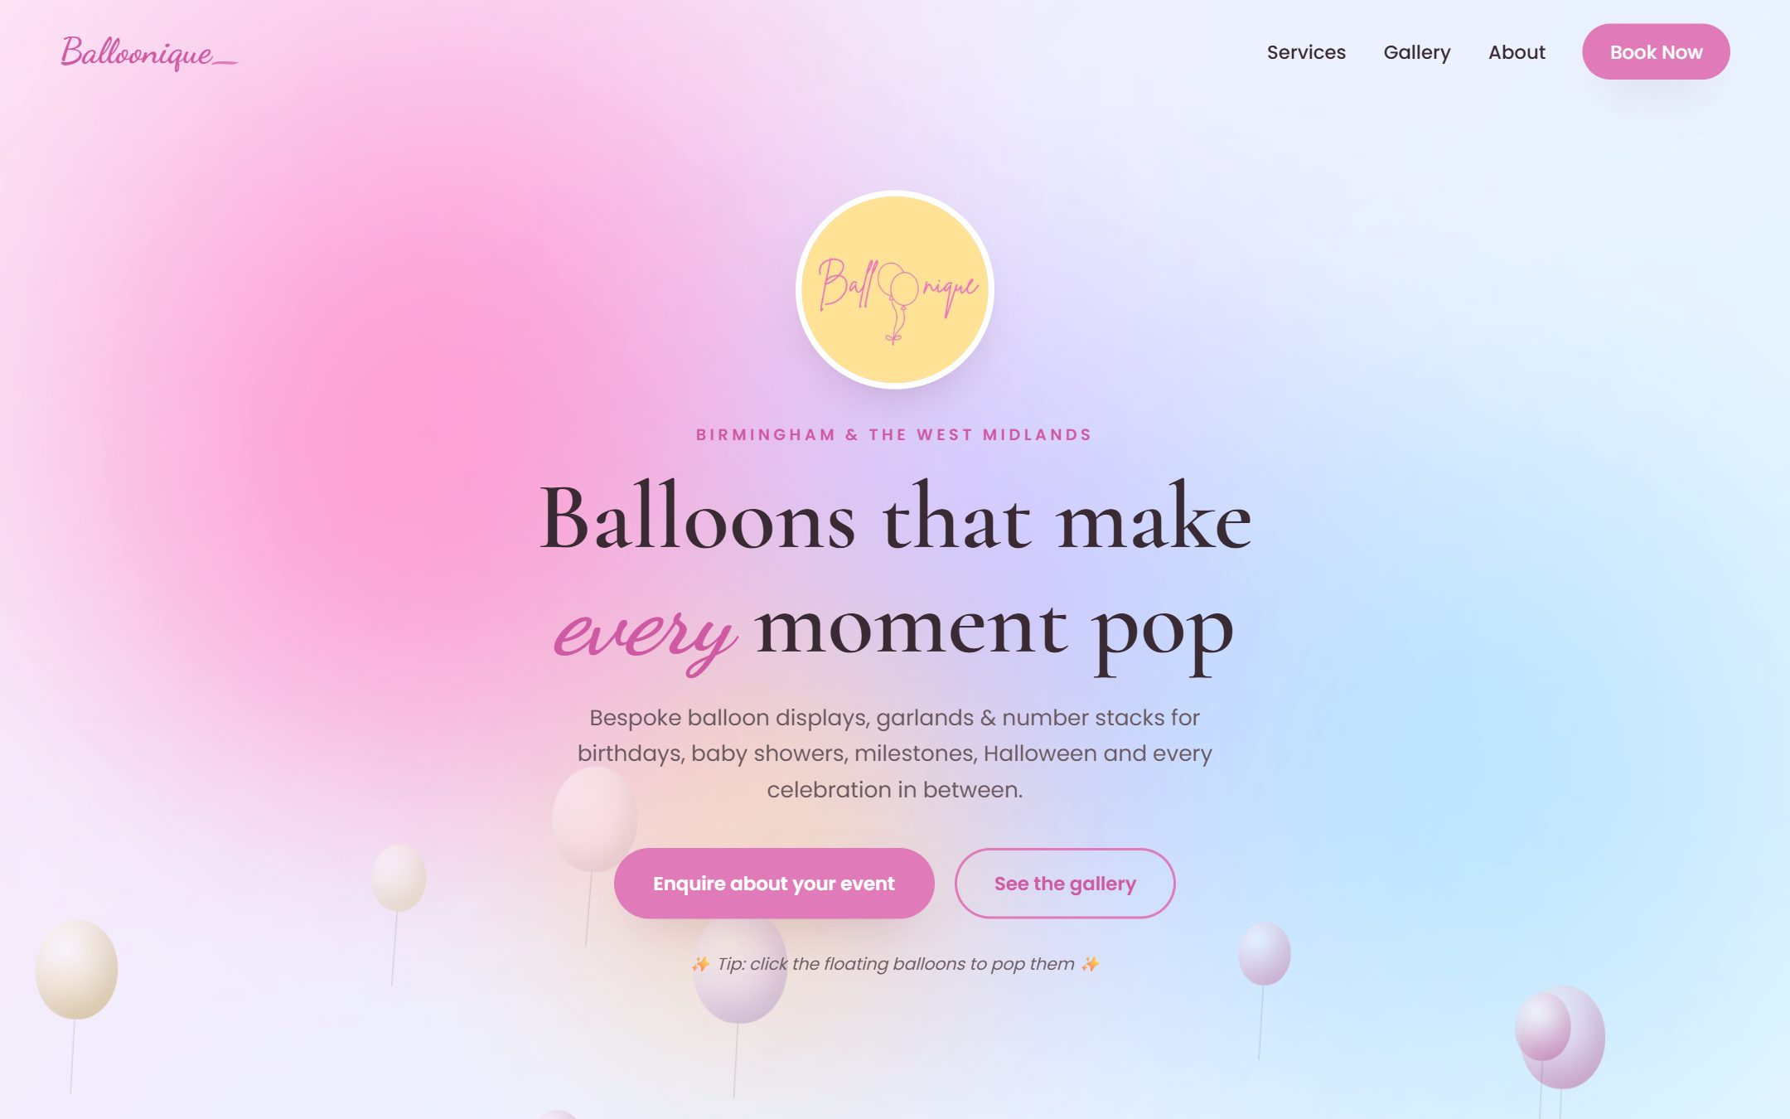
03
Balloonique
Balloon & events business · Interactive website
A joyful, interactive site for a Birmingham balloon studio. Poppable balloons, confetti and a lightbox gallery, built to convert enquiries.
WEB DESIGN · INTERACTIVE · LOCAL BUSINESS
▸ balloonique.co.uk

Slide 5
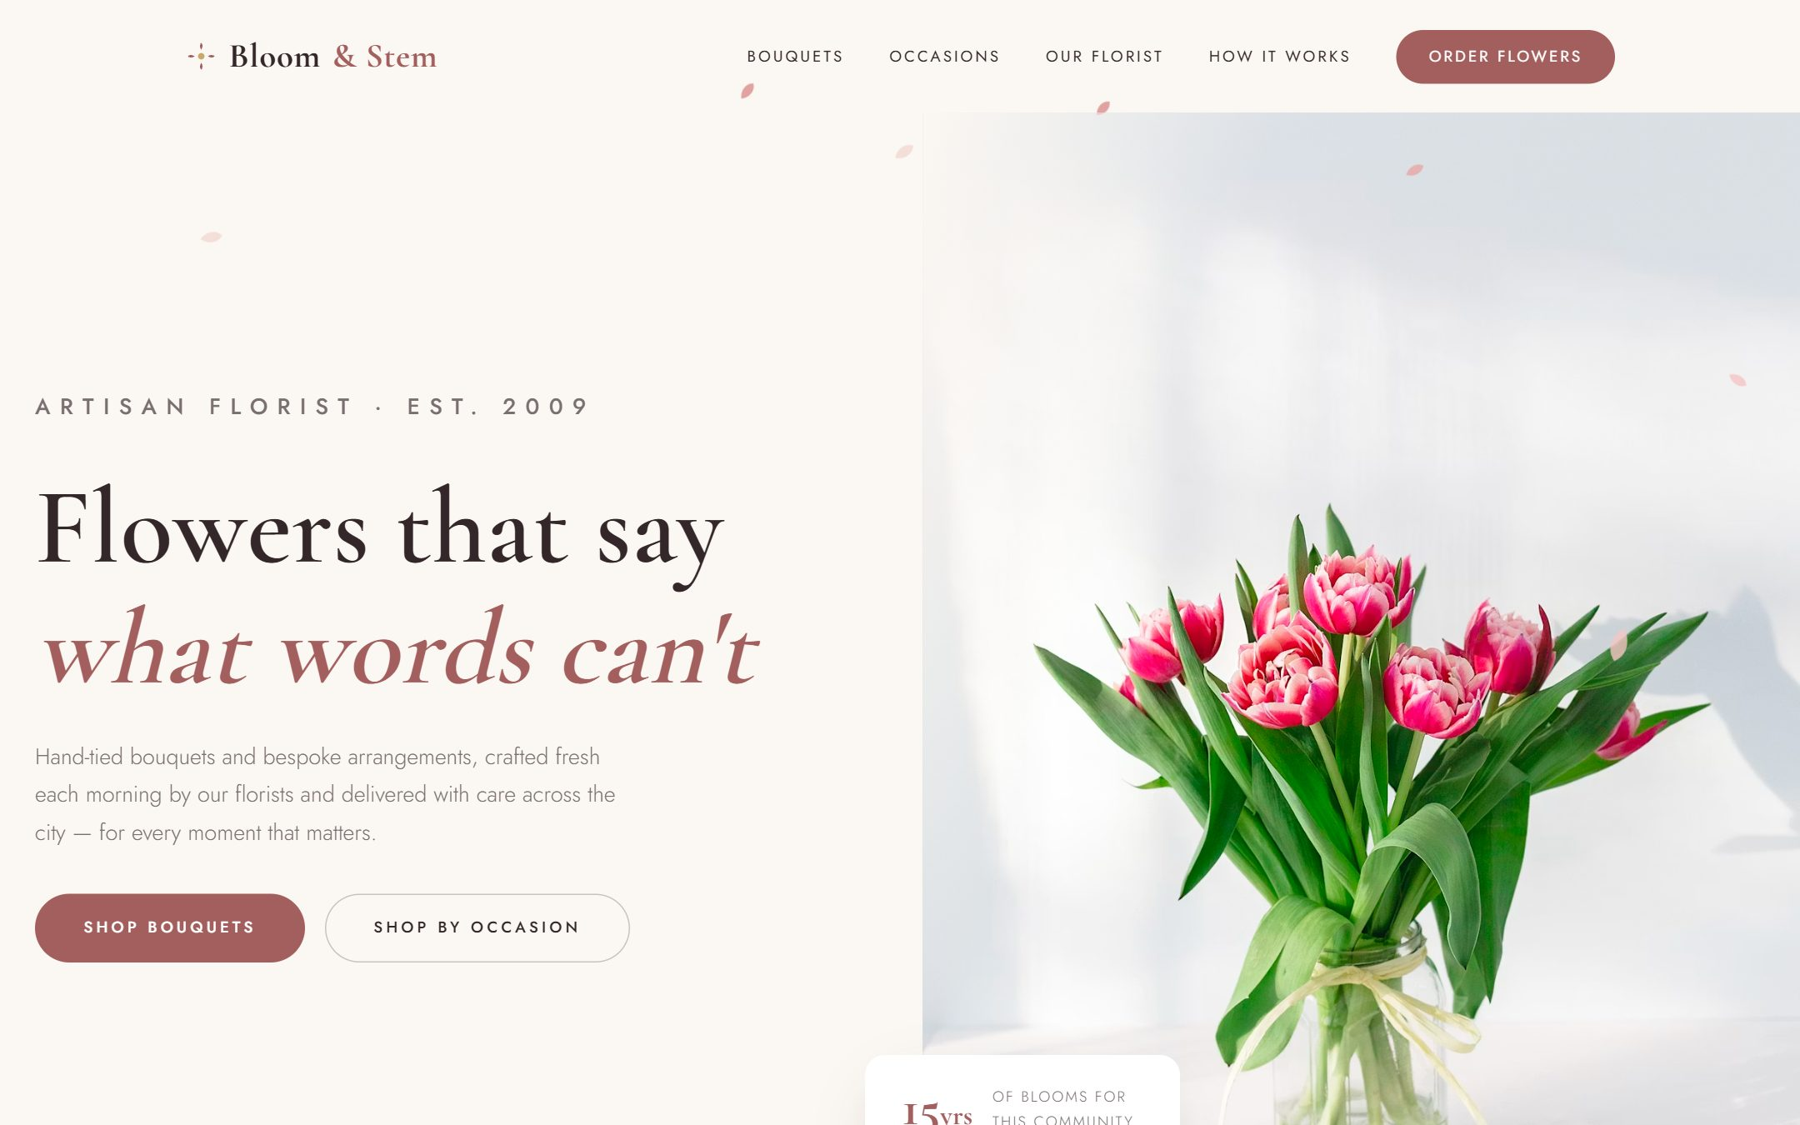
04
Bloom & Stem
Artisan florist · Website & brand
An elegant site for an artisan florist. Soft editorial styling, a full-bleed gallery, and an easy route from browsing to placing an order.
WEB DESIGN · BRANDING · FLORIST
▸ Private build

Slide 6
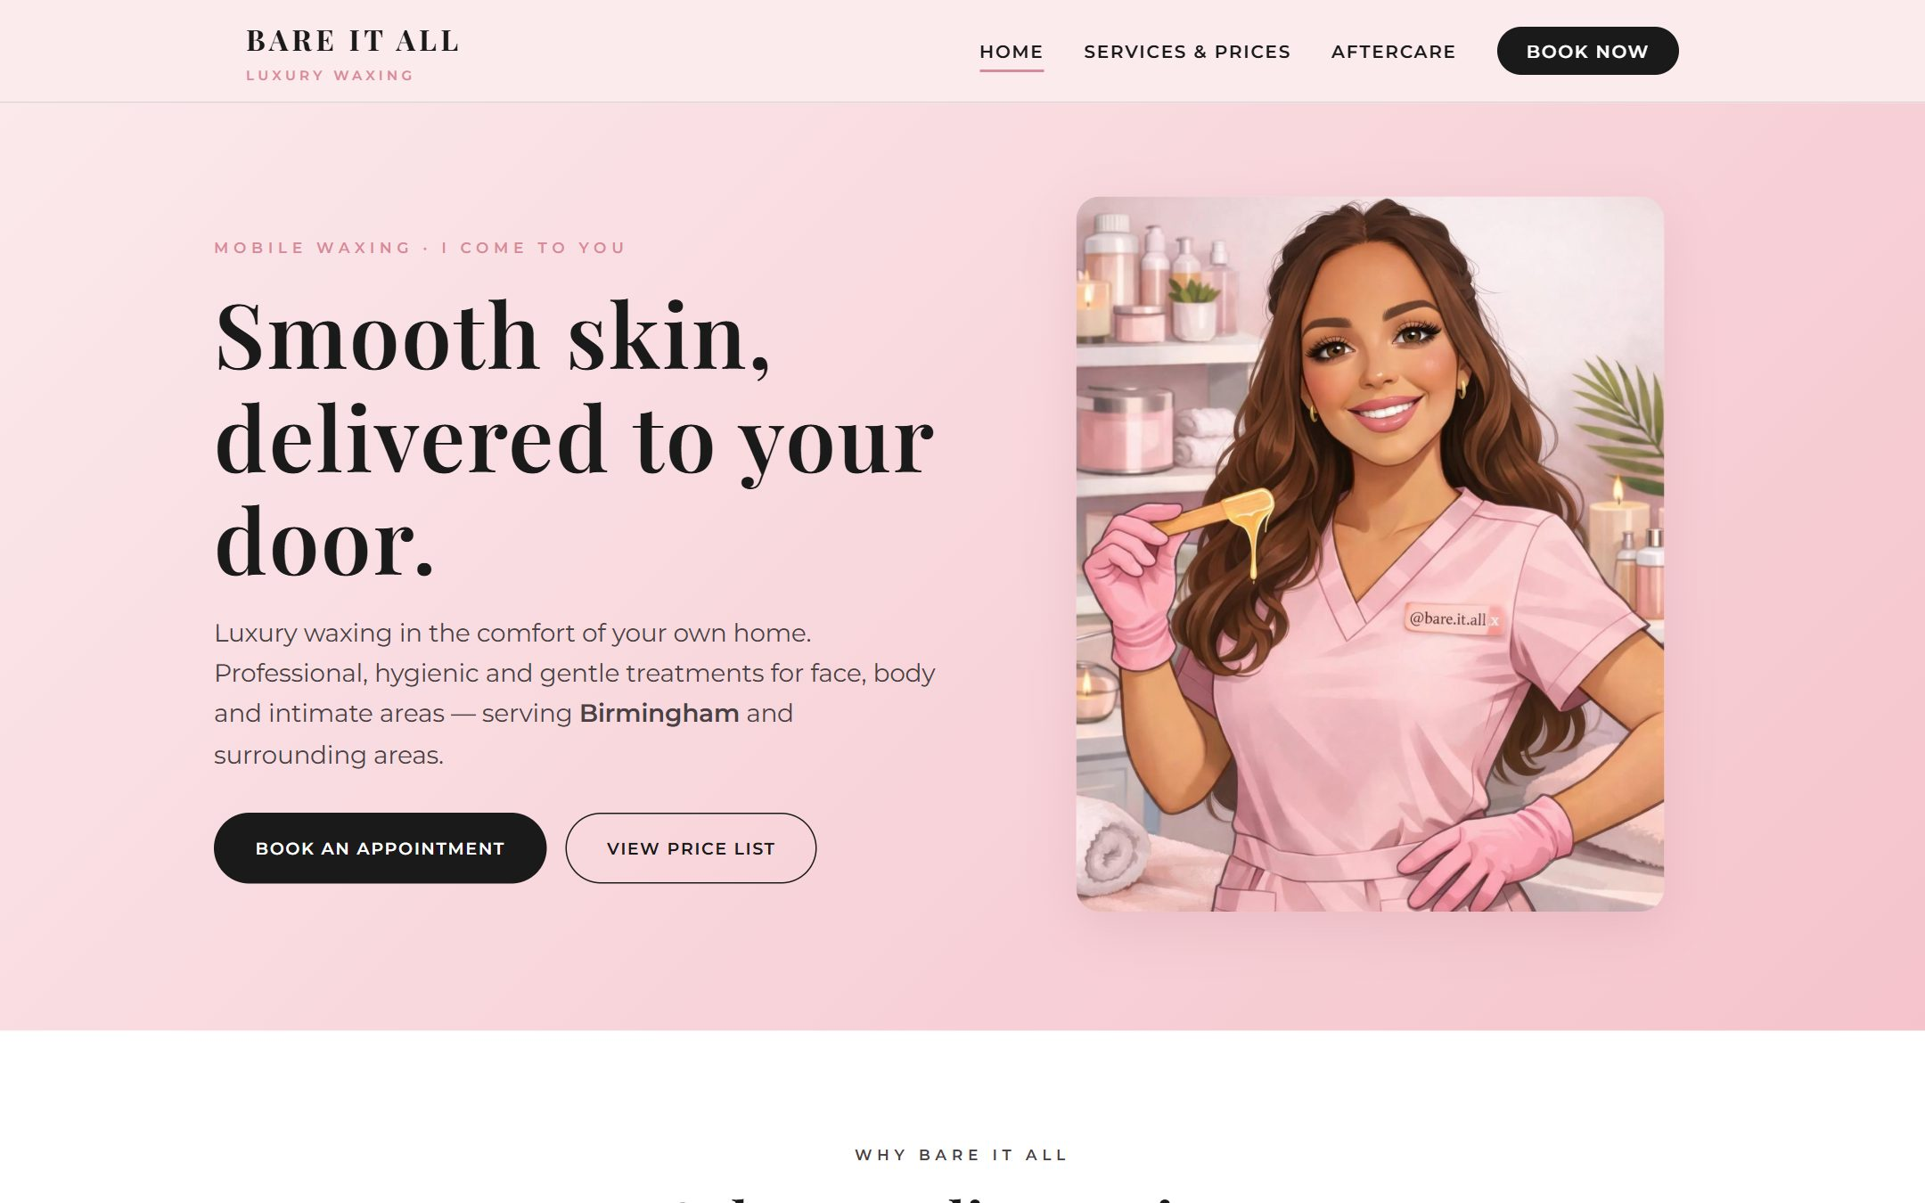
05
Bare It All
Luxury mobile waxing · Website & brand
A premium multi-page site for a mobile beauty brand. Soft styling, clear pricing, and a booking-first layout that turns visitors into appointments.
WEB DESIGN · BRANDING · BOOKING
▸ Private build

Slide 7
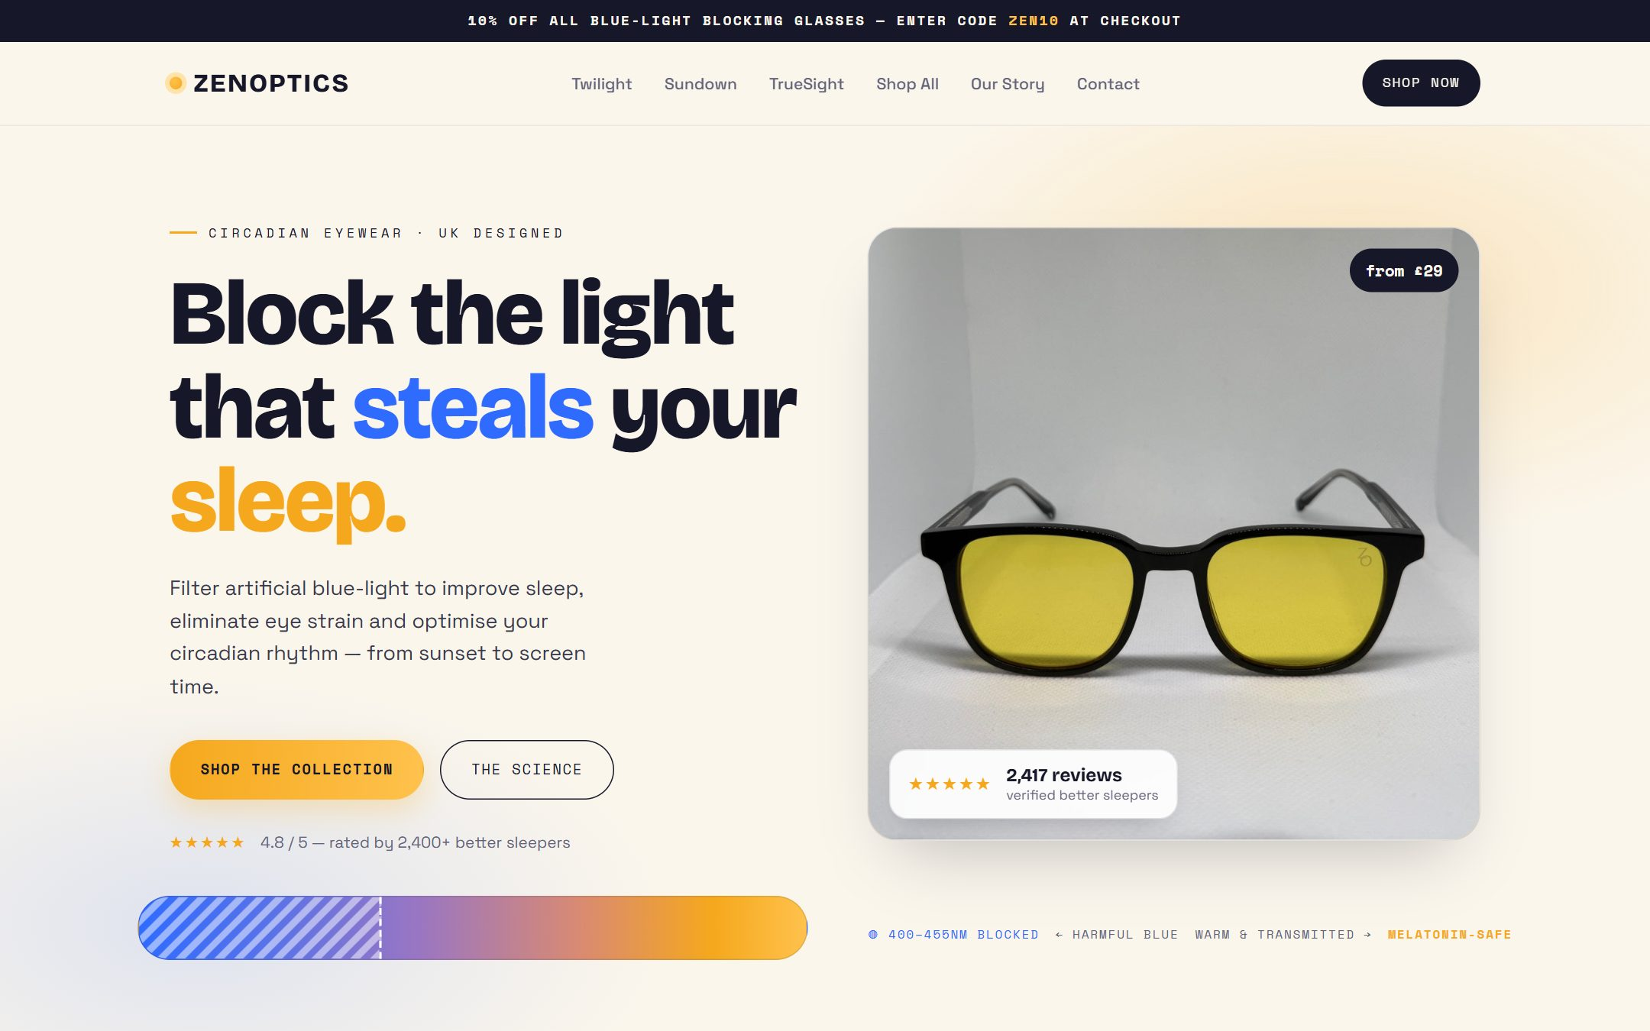
06
Zenoptics
Blue-light eyewear · E-commerce rebuild
A modern rebuild for a blue-light eyewear brand. A calm circadian-dusk palette, clearer product storytelling, and a smoother path to checkout.
WEB DESIGN · E-COMMERCE · REBUILD
▸ Rebuild

Slide 8
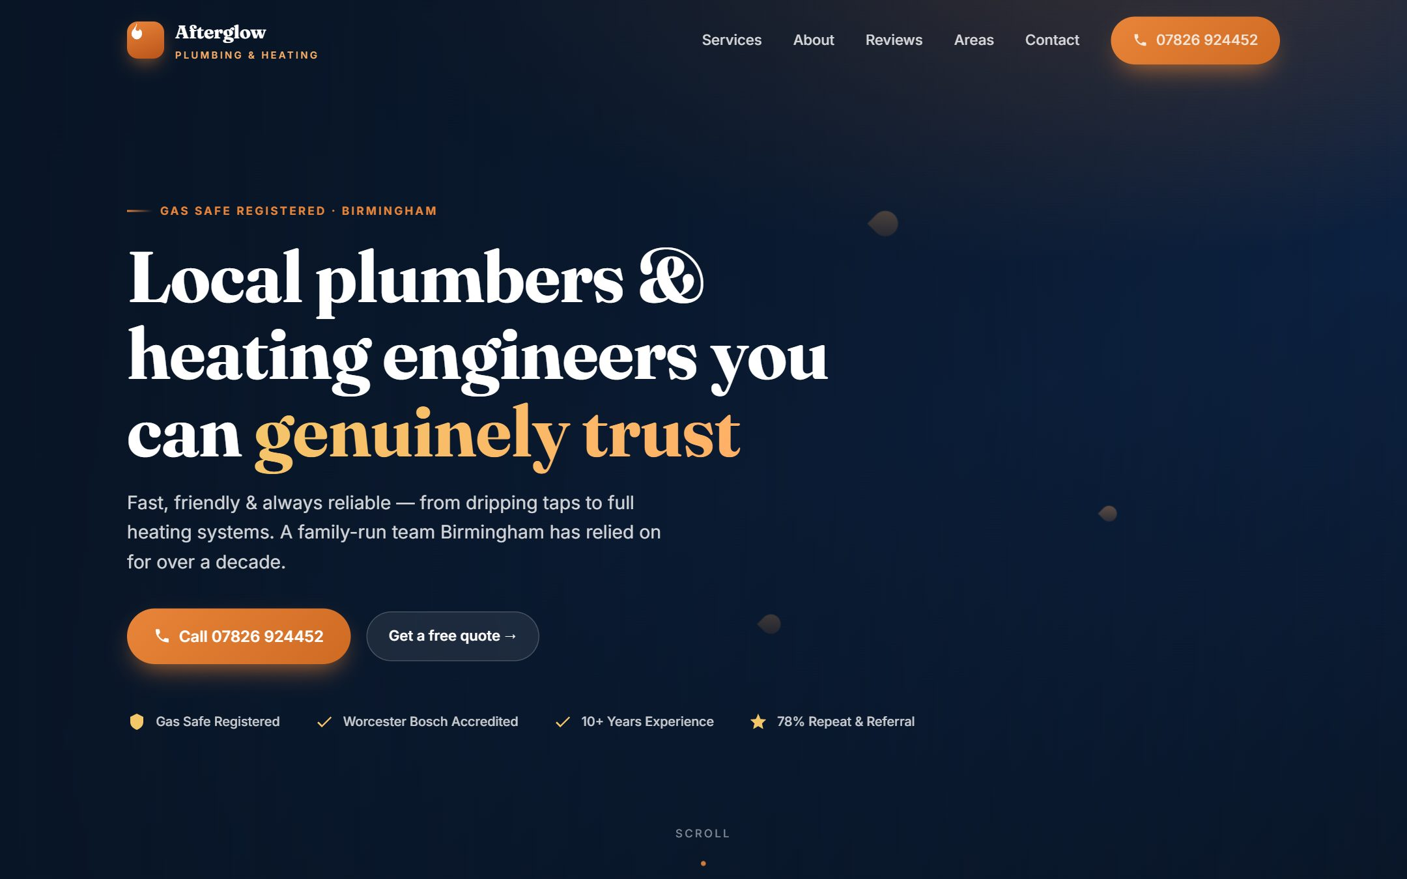
07
Afterglow
Plumbing & heating · Website & brand
A premium site for a Birmingham plumbing and heating firm. Navy and copper styling, real services and reviews, and actions that turn visitors into booked jobs.
WEB DESIGN · BRANDING · LOCAL SERVICE
▸ Private build

Slide 9
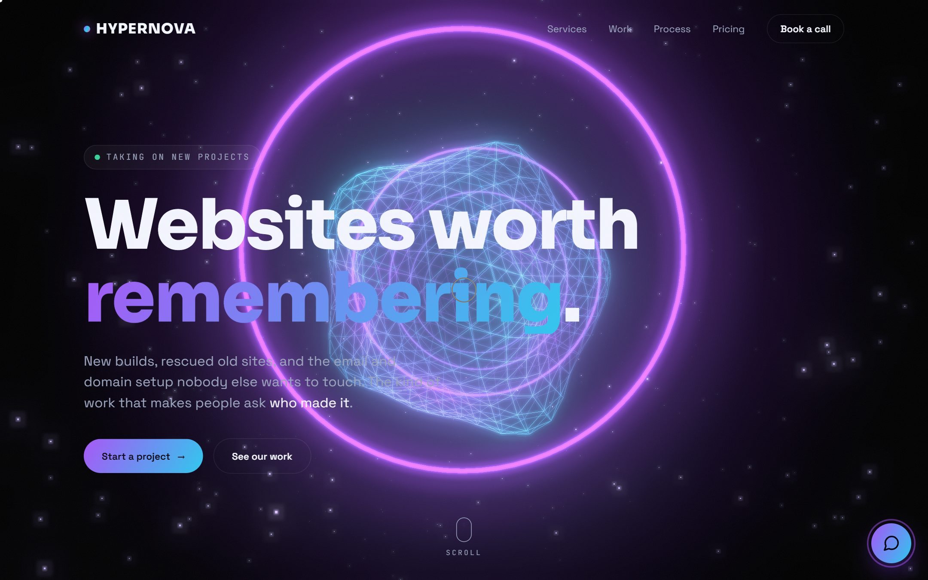
08
HYPERNOVA
Our studio site · 3D web experience
A real-time 3D scene you fly through as you scroll, with a built-in Concierge chat and motion tuned to make people ask who made it.
3D / WEBGL · ANIMATION · STUDIO SITE
▸ hyper-nova.co.uk

Slide 10
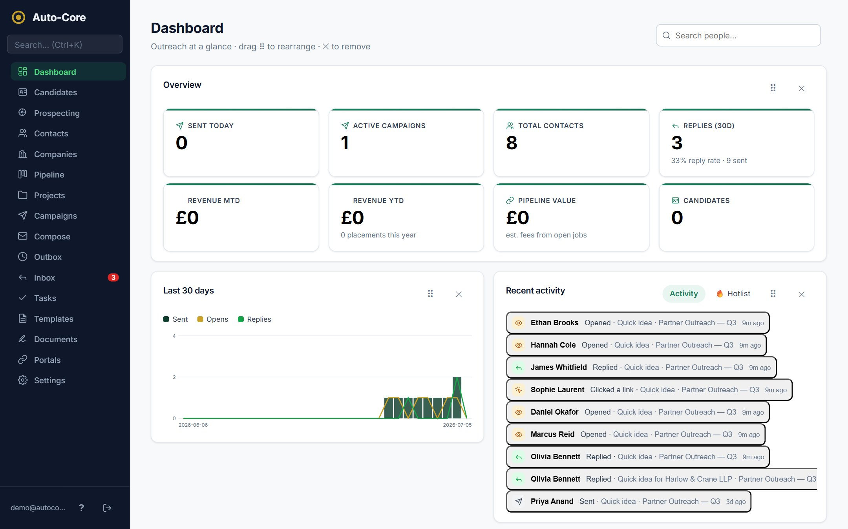
09
Auto-Core
Recruitment automation platform · Full-stack SaaS
A full recruitment outreach and automation platform: multi-mailbox sending, AI reply handling, deliverability controls, e-signatures and reporting.
SAAS PLATFORM · FULL-STACK · AUTOMATION
▸ Live demo on request

Slide 11
Let's build something
worth remembering.
hyper-nova.co.uk
New websites · Revamps · Email & domains · Interactive chat

